Slide 1
CABKARO
Arjun Temura- 2020497
Aman Kumar- 2020492
Mohd Zaid- 2020525
Debijit Pramanik- 2020504

Slide 2
Scope of project:
The project implements a database management system for an online taxi booking web application, CABKARO.
This app will help users to book cabs once they login into their account and select a pickup and drop location. Based on this information and the availability of drivers, we will map customers to drivers and register a ride.
Customers(who book a cab) and employees(cab drivers) are the stakeholders
The Customer can also select different payment options along with choice of taxi(eg Prime SUV, mini, auto etc)
Once a ride is over, the driver is made availability is updated and the total fare is calculated.
This fare depends on factors like time of booking, demand for taxis on that day etc.

Slide 3
Updated Schema
Entities:
1. customer-(user_id, name,email,mobile, password)
2. booking-(user_id, booking_id, current_location, pickup, destination, otp)
3. employees-(first name ,last name ,E_id ,Phone_no ,salary, availability)
4. cars-(car_type, car_model, registration_no, mileage ,seating)
5. fares-(car_type,start, end, cost/km)
6. luxury_cars-(Movies-tv,wifi)
7. distance-(total_price,distance, booking_id)
8. payment-(payment_id, payment_type)

Slide 4
Relationships:
1. Registers: Customer to booking-one to many
2. Total_journey: Booking to distance-one to one
3. Cost: Cars to fares-one to one
4. Luxury_cars is a child relation of cars relation (inheritance)
5. Rides relation: Ternary relationship between booking , cars and employees (one to one between any to relations )
6. PaymentType:Payment to Booking-one to many

Slide 5
Changes after mid evaluation
Boolean attribute in Employee table (availability) to keep track Availability of Driver at a particular time.
Updated the ‘fares’ table, to store fares based on time of booking(eg. Fares are higher during office hours). New attribute start, end to keep track of the interval of cab booking.
New table “Payment” , with attributes payment_id(int) and payment_type (varchar)to specify the payment method for a ride.(UPI/Credit Card etc) . Therefore a new attribute, payment_id was added to the booking table

Slide 6
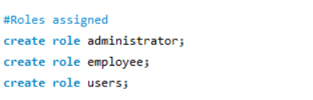
Roles assigned:
Administrator
Employee
Users
Grants and Views for all roles are implemented in MySQL.

Slide 7
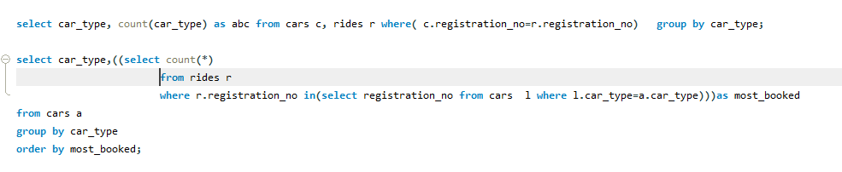
SQL Query Optimisation:
Counting how many cars of a particular car type has been booked in a day.
These two queries yield the same result.
However, the one with embedded query (second query) could take more time than the simple join one(first query). So here we could use the join one (first query) as the optimal query.

Slide 8
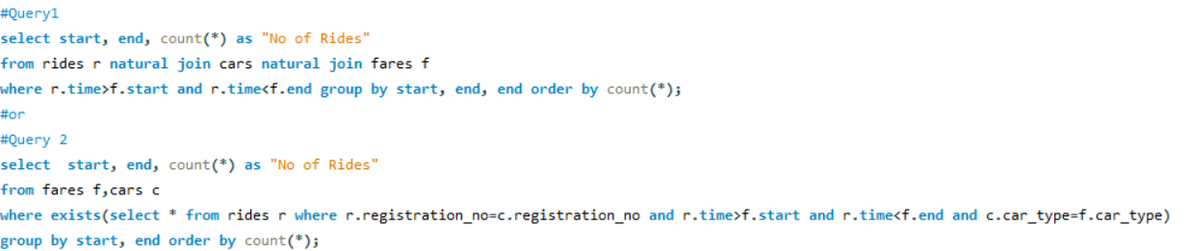
2. To show no. of rides booked in different time intervals for the day
Among the two queries, Query 1 uses natural join operation on 3 tables and Query 2 uses nested queries with nested queries. As nested query will take more time to give the same result, Query 1 is more optimal

Slide 9
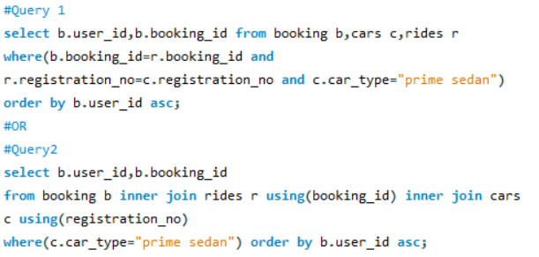
3. To find customers who traveled in prime sedan?
In query 2, we have used inner join on booking, rides and cars whereas in query 1 we have used nested queries with join. Clearly Query 2 is optimal

Slide 10
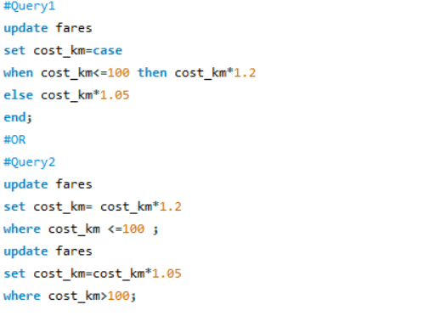
4. Update the cost/km depending on the present fares(in response to fuel price hike)
Query 1 uses switch case to complete the task in one query. However, Query 2 does the same task using two queries separately using where clause. Hence, Query 1 is more optimal.

Slide 11
Query optimization
5. Indexing
The use of proper indexing is first step to optimise the query. There are some important steps to use or create index .
Indexing helps in faster retrieval of records
For example if we want to search tuples based on some other attributes except the primary key
We would end up with much tuples with that same attribute
In such case we might require a unique index not which is not just the primary key but combination fo that attribute which is not
Primary key and of the primary key

Slide 12
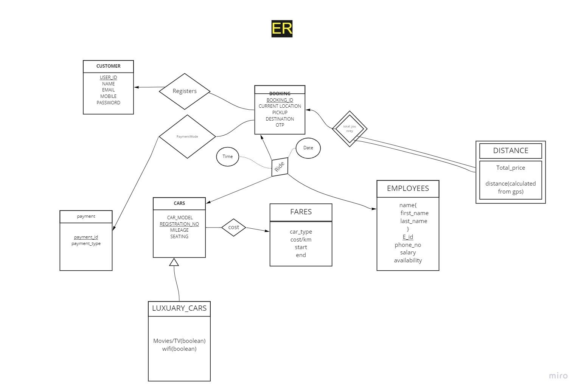

Slide 13
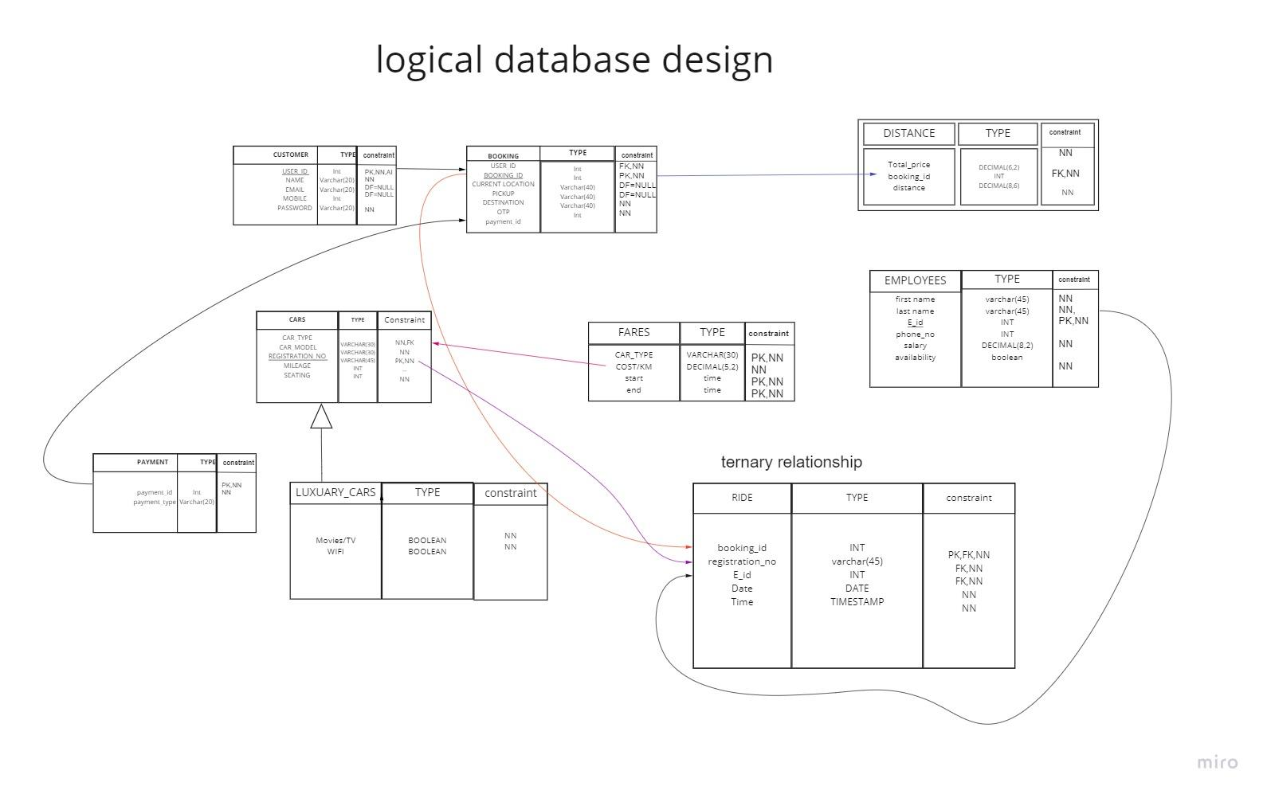

Slide 14
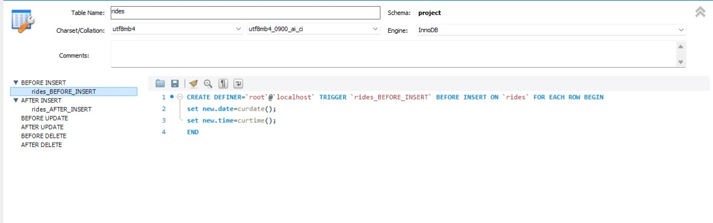
TRIGGERS
In rides table we had created a before insert trigger, this trigger insert or set date and time of record to current time.

Slide 15
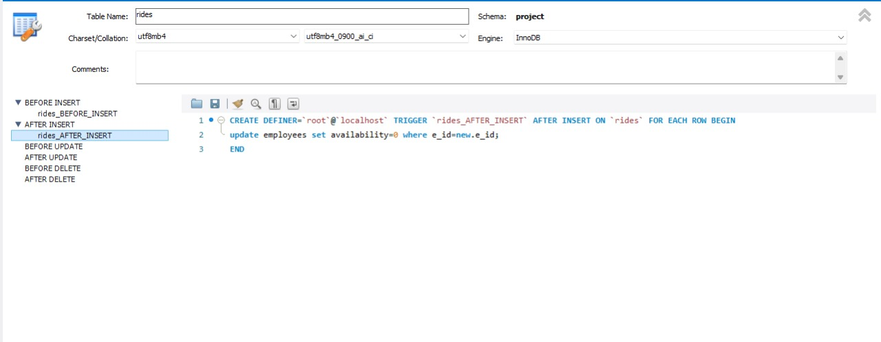
2. In rides table we had created after insert trigger, this trigger makes changes to employees table it sets availability to false or 0.

Slide 16
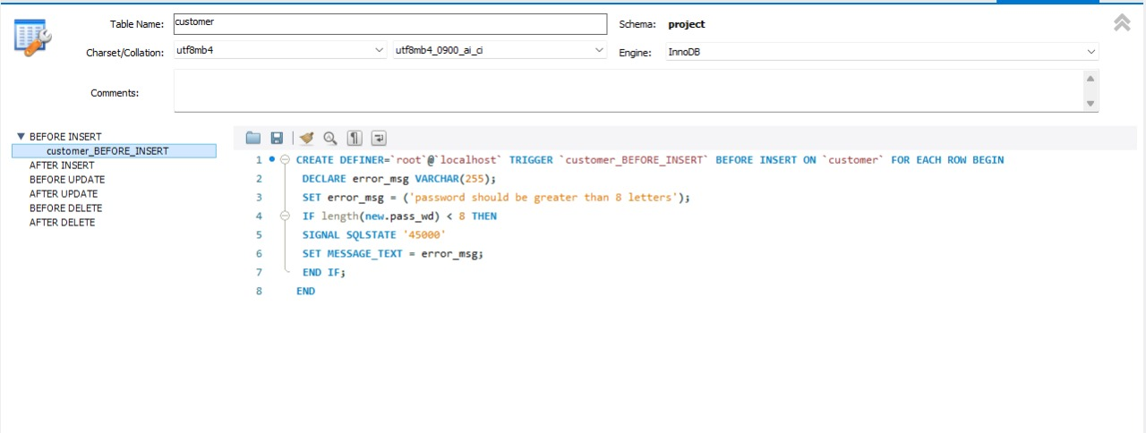
3. In customer table we created before insert trigger, this trigger gets triggered when u try to entry password less than 8 characters it will give you an error.

Slide 17
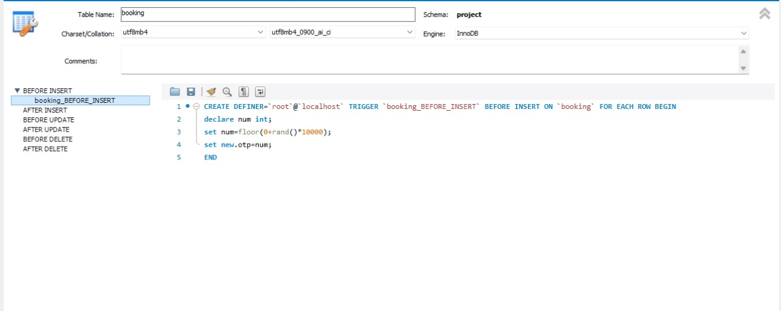
4. In booking table we created before insert trigger, this trigger gets triggered when u insert a row in table and trigger adds OTP for you.

Slide 18
INDEXING
CREATE INDEX ind_ride ON rides (booking_id,time);
CREATE INDEX ind_customer ON customer (name,user_id);
CREATE INDEX ind_booking ON booking (user_id);
CREATE INDEX ind_emp ON employees(first_name,e_id);
CREATE INDEX ind_cars ON cars(car_type);
CREATE Unique INDEX ind_fares ON fares (start,end,car_type);
TO CHECK INDEXES ON TABLE WE USE SHOW INDEXES from table_name
command

Slide 19

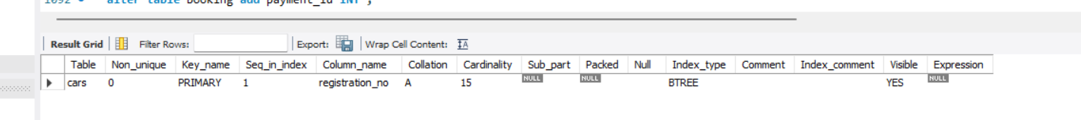
cars

Slide 20

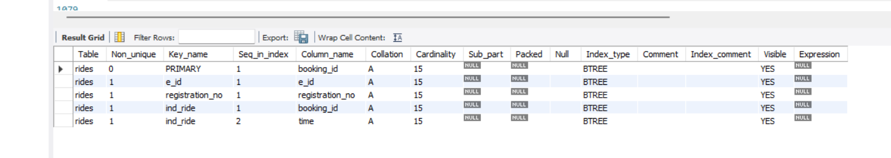
rides

Slide 21


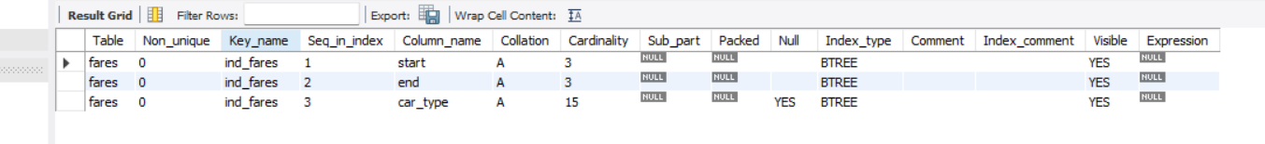
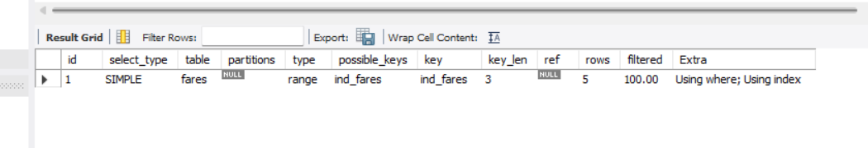
fares

Slide 22
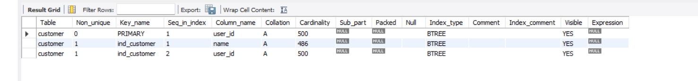
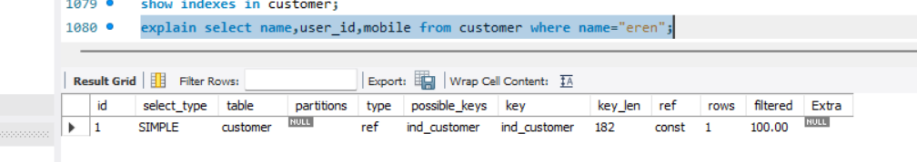
customer

Slide 23

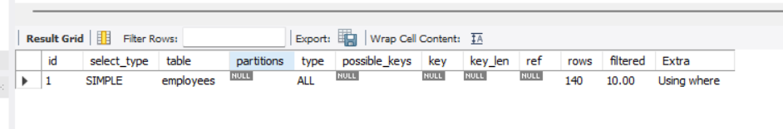
employees

